Slide 1
Course: EEE 312 DIGITAL SIGNAL PROCESSING LABORATORY Project Name: BRAIN TUMOR DETECTION USING IMAGE PROCESSING METHOD Project Group : 01 Student IDs : 1806167-168-194-195

Slide 2
INTRODUCTION

Slide 3
Brain tumor is the abnormal growth of brain tissues which can be benign ( non-cancerous ) or, malignant( cancerous ). In the latter case, it proves fatal 60% of the time if not detected at an early stage. Thus, brain tumor detection by image processing method provides us an in-depth view of the tumor and its projected growth.

Slide 4
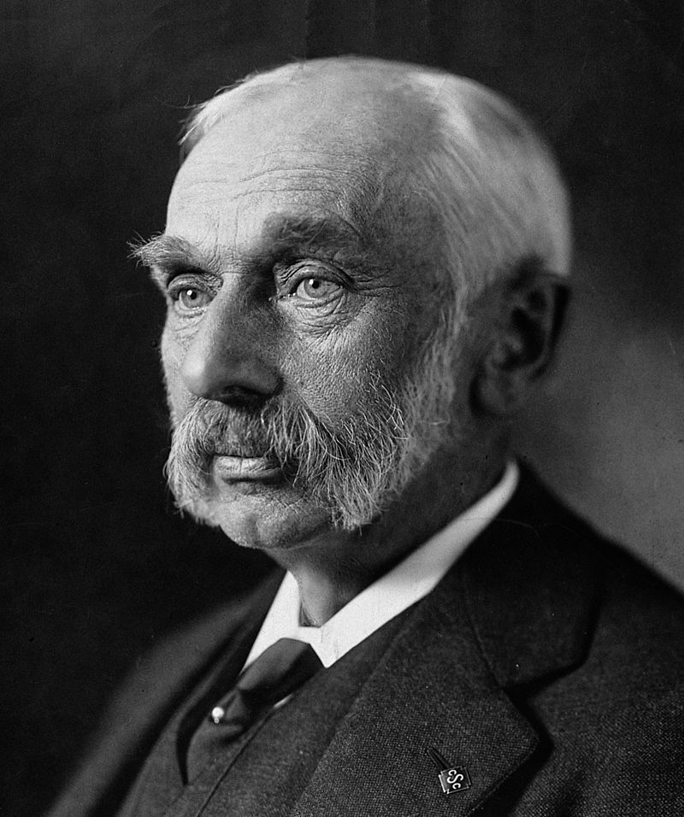
Sir Rickman John Godlee (15 February 1849 – 18 April 1925)
The first doctor to surgically remove a brain tumor in 1884, thus pioneering modern brain surgery.

Slide 5
OBJECTIVES

Slide 6
Brain Tumor Detection
Testing Accuracy of Algorithm

Slide 7
WORKFLOW

Slide 8
IMAGE
INPUT
IMAGE
PRE-
PROCESSING
IMAGE ENHANCE-
MENT
SKULL STRIPPING
MORPHOLOGI-CAL OPERATION
OTSU,
WATERSHED,
FUZZY-C CLUSTERING
COMBINED
RESULT
IMAGE
SEGMENTA-
TION
FEATURE EXTRACTION
PREDICTION
TUMOR or,
NON TUMOR
DETECT
ACCURACY
CHECK

Slide 9
METHODOLOGY

Slide 10
STEP 01 IMAGE PRE-PROCESSING

Slide 11
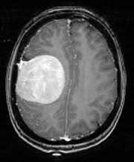
First, We Take A Sample MRI Image of The Brain

Slide 12
STEP 02 IMAGE ENHANCEMENT

Slide 13
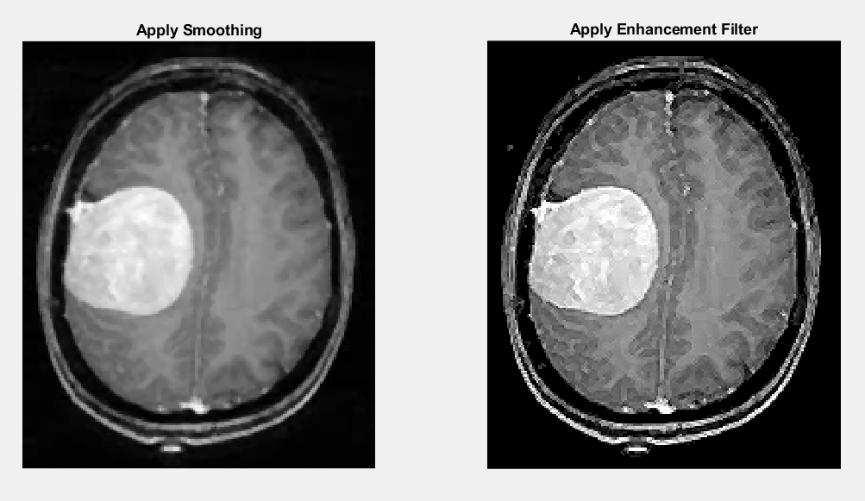
RGB TO GRAY
SMOOTHING
REMOVING WHITE
BLOBS
ENHANCEMENT
ADAPTIVE HISTOGRAM
EQUALIZATION

Slide 14
STEP 03 SKULL STRIPPING

Slide 15
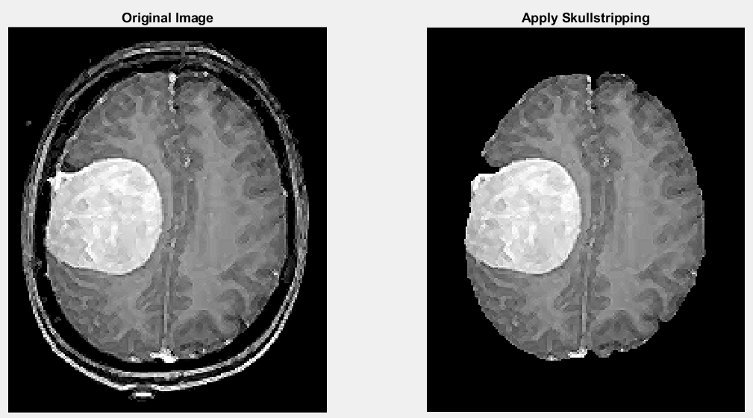
FINAL
RESULTS

Slide 16
STEP 04 IMAGE SEGMENTATION

Slide 17
3 METHODS COMBINED
OTSU
Optimizes the separation of foreground and background by minimizing the intra-class variance of pixel values.
WATER-SHED
Is based on the similarities of neighbouring pixels in regions.
FUZZY C-MEAN CLUSTERING
Assigns a probability value of pixels being in the two clusters and takes the cluster which has the highest possibility.

Slide 18
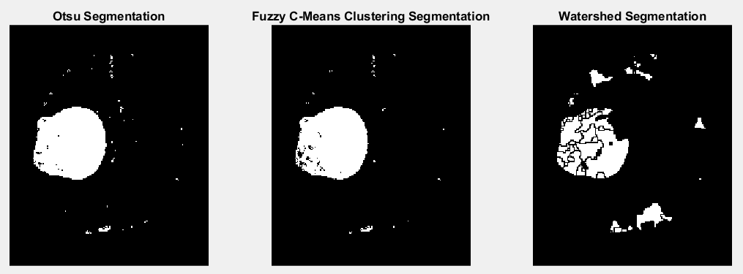
RESULTS

Slide 19
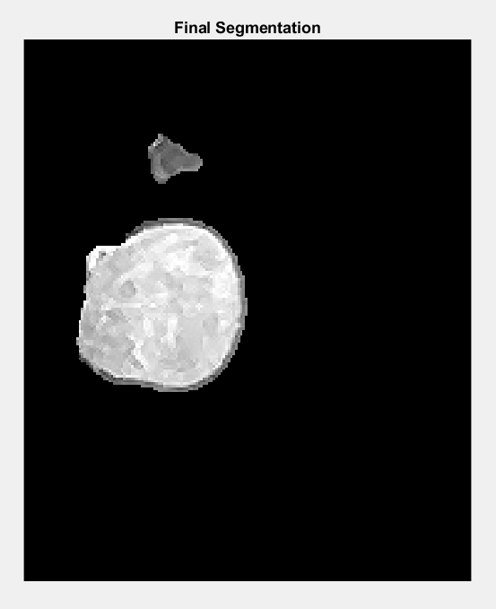
COMBINED RESULT

Slide 20
STEP 05 MORPHOLOGICAL OPERATION

Slide 21
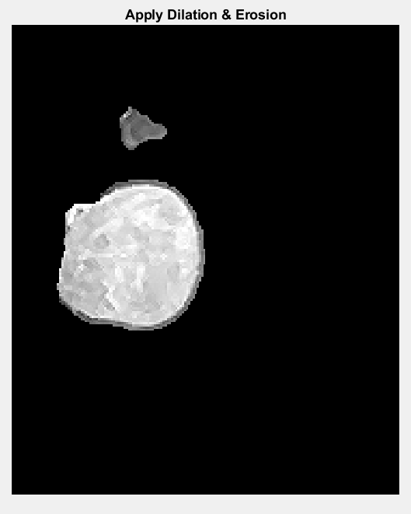
RESULT

Slide 22
STEP 06 FEATURE EXTRACTION

Slide 23
4 Features :
Contrast, Correlation, Entropy and Standard Deviation
GRAY LEVEL CO_OCCURRENCE MATRIX for feature extraction
A GLCM gives tabulated information about the positions of pixels with similar gray level values in an image

Slide 24
STEP 07 PREDICTION

Slide 25
TRAINING = 600 TESTING = 200 WITH TUMOR = 355 WITHOUT TUMOR = 445 ML TREE MODEL USES INBUILT fitctree()
DATASET
SOURCE: KAGGLE

Slide 26
STEP 08 DETECTION

Slide 27
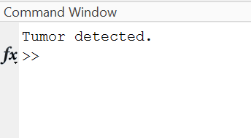
FINAL OUTPUT SHOWS SAMPLE MRI IMAGE HAS TUMOR

Slide 28
ACCURACY CHECK

Slide 29
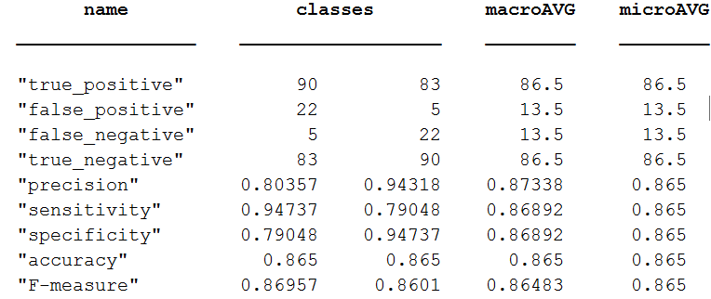
ACCURACY
PRECISION
RECALL
SPECIFICITY
F1 MEASURE

Slide 30
LIMITATIONS

Slide 31
ONLY FOR 2D IMAGES
THRESHOLD
ASSUMP-TIONS
CAN’T DETECT TYPES OF TUMOR

Slide 32




TEAM
MOYTRI GHOSAL 1806167
EEE DEPT
BANGLADESH UNIVERISTY OF ENGINEERING AND TECHNOLOGY
SANDIPA CHOWDHURY 1806168
EEE DEPT
BANGLADESH UNIVERISTY OF ENGINEERING AND TECHNOLOGY
SHIHAB WAHED 1806194
EEE DEPT
BANGLADESH UNIVERISTY OF ENGINEERING AND TECHNOLOGY
AYE THEIN MAUNG 1806195
EEE DEPT
BANGLADESH UNIVERISTY OF ENGINEERING AND TECHNOLOGY

Slide 33
THANK YOU !

Slide 34
ANY QUESTIONS?

